Slide 1
Flow Control Instructions,

Slide 2
Overview
For assembly language-programs to carry out useful tasks, there must be a way to make decisions and repeat sections of code.
JUMP
LOOP
The jump and loop instructions transfer control to another part
Of the program. this transfer can be unconditional or can depend on a particular combination of status flag settings.

Slide 3
Topics
Control Flow Structure
Conditional Jump
Unconditional Jump
Control Flow Structures
IF-THEN
IF-THEN-ELSE
CASE
Branches with Compound Conditions

Slide 4

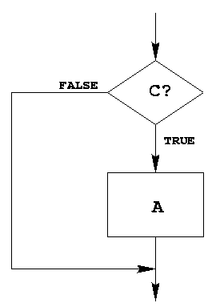
IF-THEN Structure
Replace the number in AX by its absolute value.
IF AX < 0 THEN
replace AX by –AX
END_IF
CMP AX, 0 ; AX < 0?
JNL END_IF ; jump if Not Less than
NEG AX
END_IF:
Example 6-2: Assembly Language Programming

Slide 5
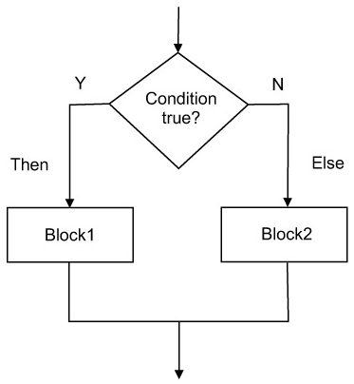
IF-THEN-ELSE Structure
Suppose AL and BL contains ASCII characters.
Display the one that comes first in the character sequence
IF AL <= BL THEN
display the character in AL
ELSE
display the character in BL
END_ID
MOV AH, 2 ; prepare to display
CMP AL, BL ; AL <= BL?
JNBE ELSE_ ; jump if Not Below/Equal
MOV DL, AL
JMP DISPLAY
ELSE_:
MOV DL, BL
DISPLAY:
INT 21h
END_IF:
Example 6-3: Assembly Language Programming

Slide 6
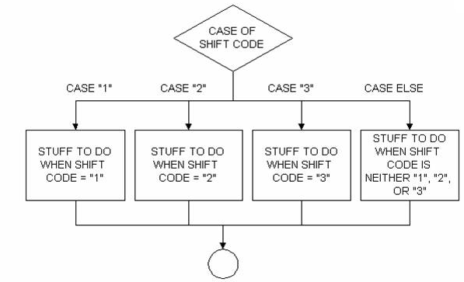
CASE
A CASE is a multi-way branch structure
CASE expression
1: statements_1
2: statements_2
*
*
n: statements_n
END_CASE

Slide 7
CASE Example
If AX contains a negative number, put -1 in BX;
If AX contains 0, put 0 in BX;
If AX contains a positive number, put 1 in BX.
CASE AX
< 0: put -1 in BX
= 0: put 0 in BX
> 0: put 1 in BX
END_CASE
CMP AX, 0 ; test AX
JL NEGATIVE ; AX < 0
JE ZERO ; AX = 0
JG POSITIVE ; AX > 0
NEGATIVE:
MOV BX, -1 ; put -1 in BX
JMP END_CASE ; and exit
ZERO:
MOV BX, 0 ; put 0 in BX
JMP END_CASE ; and exit
POSITIVE:
MOV BX, 1 ; put 1 in BX
END_CASE:
JL – Jump if less than
JE – if equal
JG – if greater than
Example 6-4: Assembly Language Programming

Slide 8
More CASE Example
If AL contains 1 or 3, display “o” for odd;
If AL contains 2 or 4, display “e” for even;
CASE AL
1, 3: display ‘o’
2, 4: display ‘e’
END_CASE
CMP AL, 1 ; AL = 1?
JE ODD ; yes, display ‘o’
CMP AL, 3 ; AL = 3?
JE ODD ; yes, display ‘o’
CMP AL, 2 ; AL = 2?
JE EVEN ; yes, display ‘e’
CMP AL, 4 ; AL = 4?
JE EVEN ; yes, display ‘e’
JMP END_CASE
ODD:
MOV DL, ‘o’ ; get ‘o’
JMP DISPLAY ; go to display
EVEN:
MOV DL, ‘e’ ; get ‘e’
DISPLAY:
MOV AH, 2 ; char display function
INT 21h ; display character
END_CASE
JE – if equal
Example 6-4: Assembly Language Programming

Slide 9
Agenda
Control Flow Structure
Conditional Jump
Unconditional Jump
Control Flow Structures
IF-THEN
IF-THEN-ELSE
CASE
Branches with Compound Conditions

Slide 10
Branches with Compound Conditions
Branching condition in an IF or CASE can be
condition_1 AND condition_2
or,
condition_1 OR condition_2
First one is AND condition
Second one is OR condition

Slide 11
AND Conditions
Read a character, and if it’s an uppercase letter, display it.
Read a character into AL
IF (‘A’ <= character ) and (character <= ‘Z’) THEN
display the character
END_IF
MOV AH, 1 ; read character function
INT 21h ; char in AL
CMP AL, ‘A’ ; char >= ‘A’
JNGE END_IF ; no, exit ➔ jump if Not Greater Than or Equal to
CMP AL, ‘Z’ ; char <= ‘Z’
JNLE END_IF ; no, exit ➔ jump if Not Less Than or Equal to
MOV DL, AL ; get char
MOV AH, 2 ; display character function
INT 21h ; display the character
END_IF:
Example 6-6: Assembly Language Programming

Slide 12
OR Conditions
Read a character, and if it’s ‘y’ or ‘Y’, display it; otherwise, terminate the program
Read a character into AL
IF (character = ‘y’) or (character = ‘Y’) THEN
display the character
ELSE
terminate the program
END_IF
MOV AH, 1 ; read character function
INT 21h ; char in AL
CMP AL, ‘Y’ ; char = ‘Y’
JE THEN ; yes, display the char
CMP AL, ‘y’ ; char = ‘y’
JE THEN ; yes, display the char
JMP ELSE_
THEN:
MOV DL, AL ; get the char
MOV AH, 2 ; display character function
INT 21h ; display the character
ELSE_:
JE – if equal
Example 6-7: Assembly Language Programming

Slide 13
Topics – 6.4.2
Control Flow Structures
FOR Loop
WHILE Loop
REPEAT-UNTIL Loop
Load Effective Address (LEA) Instruction
Programming with Higher Level Structures

Slide 14
C – loops
for
While
do while
for (Start value; end condition; increase value)
statement;
int main()
{
int i;
for (i = 0; i < 10; i++)
{
printf ("Hello\n");
printf ("World\n");
}
return 0;
}

Slide 15
C – while
int main()
{
int counter, howmuch;
scanf("%d", &howmuch);
counter = 0;
while ( counter < howmuch)
{
counter++;
printf("%d\n", counter);
}
return 0;
}

Slide 16
C – do while
do
{
do something;
}
while (expression);
int main()
{
int counter, howmuch;
scanf("%d", &howmuch);
counter = 0;
do
{
counter++;
printf("%d\n", counter);
}
while ( counter < howmuch);
return 0;
}

Slide 17
LOOP
Instruction: LOOP destination_label
Counter for LOOP is CX register, which is initialized to loop_count
CX decreases automatically
If CX is NOT 0 → control transfers to destination_label
If CX = 0, the next instruction after the LOOP is done.

Slide 18
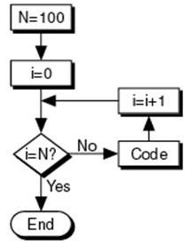
Assembly - FOR Loop
Write a program to display a row of 80 stars ‘*’
FOR 80 times DO
display ‘*’
END_FOR
MOV CX, 80 ; number of ‘*’ to display
MOV AH, 2 ; char display function
MOV DL, ‘*’ ; char to display
TOP:
INT 21h ; display a star
LOOP TOP ; repeat 80 times
Example 6-8: Assembly Language Programming

Slide 19
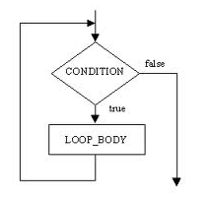
WHILE Loop
Write a program to count the characters in an input line
Initialize count to 0
Read a character
WHILE character <> carriage return DO
count = count + 1
read a character
END_WHILE
WHILE condition DO
statements
END_WHILE
MOV DX, 0 ; DX counts the characters
MOV AH, 1 ; read char function
INT 21h ; read a char in AL
WHILE_:
CMP AL, 0DH ; CR?
JE END_WHILE
INC DX
INT 21h
JMP WHILE_
END_WHILE:
Example 6-9: Assembly Language Programming

Slide 20
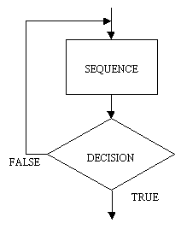
REPEAT Loop
REPEAT
statements
UNTIL condition
Write a program to read characters until a blank/space is read
REPEAT
read a character
UNTIL character is a blank
MOV AH, 1 ; read char function
REPEAT:
INT 21h ; read a char in AL
CMP AL, ‘ ‘ ; a blank?
JNE REPEAT ; no, keep reading
Example 6-10: Assembly Language Programming

Slide 21
While? Repeat?
Almost the same
WHILE:
If initially condition = FALSE → then NO ENTRY
DO WHILE: at least once inside the loop
WHILE – 2 jumps
REPEAT – 1 jump

Slide 22
So far …
Control Flow Structures
IF-THEN
IF-THEN-ELSE
CASE
FOR Loop
WHILE Loop
REPEAT-UNTIL Loop
Load Effective Address (LEA) Instruction
Programming with Higher Level Structures

Slide 23
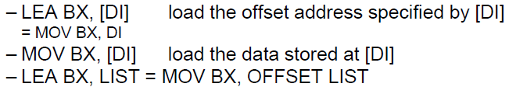
Load Effective Address
The LEA instruction loads any 16 bit register with the data address as determined
LEA vs. MOV

Slide 24
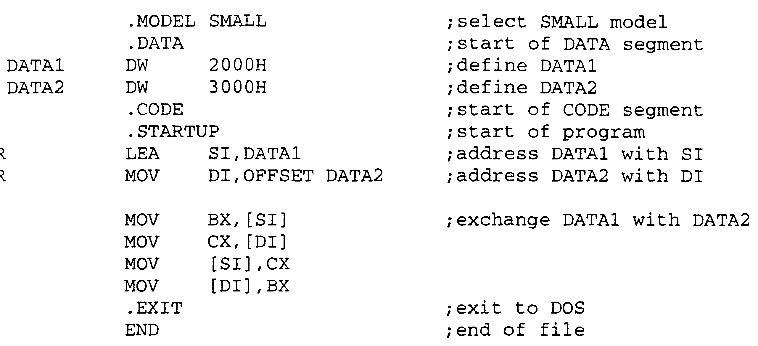
Load Effective Address Example
Write a program to exchange the contents of two memory locations
Example 4-3: Intel Microprocessors – by Brey

Slide 25
LEA vs. OFFSET Directive
OFFSET functions only with simple operands such as LIST.
LEA functions with complex operands such as [DI],
LIST [SI] etc.
OFFSET is more efficient than LEA
LEA BX, LIST is costly than MOV BX, OFFSET LIST

Slide 26
Example
Write a program to print “Hello World”
.MODEL SMALL
.DATA
PROMPT DB ‘Hello world’, 0DH, 0AH, ‘$’
.CODE
.STARTUP
; initialize DS
MOV AX, @DATA
MOV DS, AX
; display opening message
MOV AH, 9 ; display string function
LEA DX, PROMPT ; get opening message
INT 21h ; display it
.EXIT
END

Slide 27
Road Map
Control Flow Structures
IF-THEN
IF-THEN-ELSE
CASE
FOR Loop
WHILE Loop
REPEAT-UNTIL Loop
Load Effective Address (LEA) Instruction
Programming with Higher Level Structures

Slide 28
Programming with Higher Level Structures
To show how a program may be developed from high-level pseudocode to assembly code, let's solve the following problem.

Slide 29
Programming with High Level Structures
Problem
Prompt the user to enter a line of text. On the next line, display the capital letter entered that comes first alphabetically and the one that comes last. If no capital entered, display “No capital letters”.
Type a line of text:
THE QUICK BROWN FOX JUMPED
First capital = B Last capital = X

Slide 30
Top-down Program Design
Divide the problem into sub-problems
Display the opening message
Read and process a line of text
Display the results

Slide 31
Start the Program
Type a line of text:
THE QUICK BROWN FOX JUMPED
First capital = B Last capital = X
.MODEL SMALL
.STACK 100H
.DATA
PROMPT DB ‘Type a line of text’, 0DH, 0AH, ‘$’
NOCAP_MSG DB 0DH, 0AH, ‘No capitals $’
CAP_MSG DB 0DH, 0AH, ‘First capital = ‘
FIRST DB ‘]’
DB ‘ Last capital = ‘
LAST DB ‘@ $’
.CODE
.STARTUP
Follows ‘Z’ in ASCII sequence
Precedes ‘A’ in ASCII sequence
@ABCDE………………………………..XYZ]
LAST
FIRST

Slide 32
Step 1. Display the opening message
.DATA
PROMPT DB ‘Type a line of text’, 0DH, 0AH, ‘$’
; initialize DS
MOV AX, @DATA
MOV DS, AX
; display opening message
MOV AH, 9 ; display string function
LEA DX, PROMPT ; get opening message
INT 21h ; display it

Slide 33
Step 2: Read and Process a Line of Text
Read a character
WHILE character is not carriage return DO
IF character is a capital letter (*) THEN
IF character precedes first capital THEN
first capital = character
END_IF
IF character follows last capital THEN
last capital = character
END_IF
END_IF
Read a character
END_WHILE
Line (*) is actually an AND condition:
IF (‘A’ <= character) AND (character <= ‘Z’)

Slide 34
Step 2: Read and Process a Line of Text
Read a character
WHILE character is not carriage return DO
IF character is a capital letter (*) THEN
IF character precedes first capital THEN
first capital = character
END_IF
IF character follows last capital THEN
last capital = character
END_IF
END_IF
Read a character
END_WHILE
MOV AH, 1
INT 21h
WHILE_:
CMP AL, 0DH
JE END_WHILE
CMP AL, ‘A’
JNGE END_IF
CMP AL, ‘Z’
JNLE END_IF
CMP AL, FIRST ; char < FIRST or ‘]’
JNL CHECK_LAST
MOV FIRST, AL
CHECK_LAST:
CMP AL, LAST ; char > LAST or ‘@’
JNG END_IF
MOV LAST, AL
END_IF:
INT 21H
JMP WHILE_
END_WHILE:
Line (*) is actually an AND condition:
IF (‘A’ <= character) AND (character <= ‘Z’)
@ABCDE………………………………..XYZ]
LAST
FIRST

Slide 35
Step 3: Display The Results
IF no capitals were typed THEN
display “no capitals”
ELSE
display first capital and last capital
END_ID
MOV AH, 9 ; display string function
CMP FIRST, ‘]’
JNE CAPS ; no, display results
LEA DX, NOCAP_MSG
JMP DISPLAY
CAPS:
LEA DX, CAP_MSG
DISPLAY:
INT 21H
.EXIT
END
@ABCDE………………………………..XYZ]
LAST
FIRST

Slide 36
References
Many materials are from Dr. Sazzad, NSU
Ch 6, Assembly Language Programming – by Charls Marut
Section 4-3 of Intel Microprocessors – by Brey

